Slide 1

GROWTH MINDSET
A GUIDE TO EMBRACING TECHNOLOGY IN EDUCATION
by JESSICA CASILLAS

Slide 2
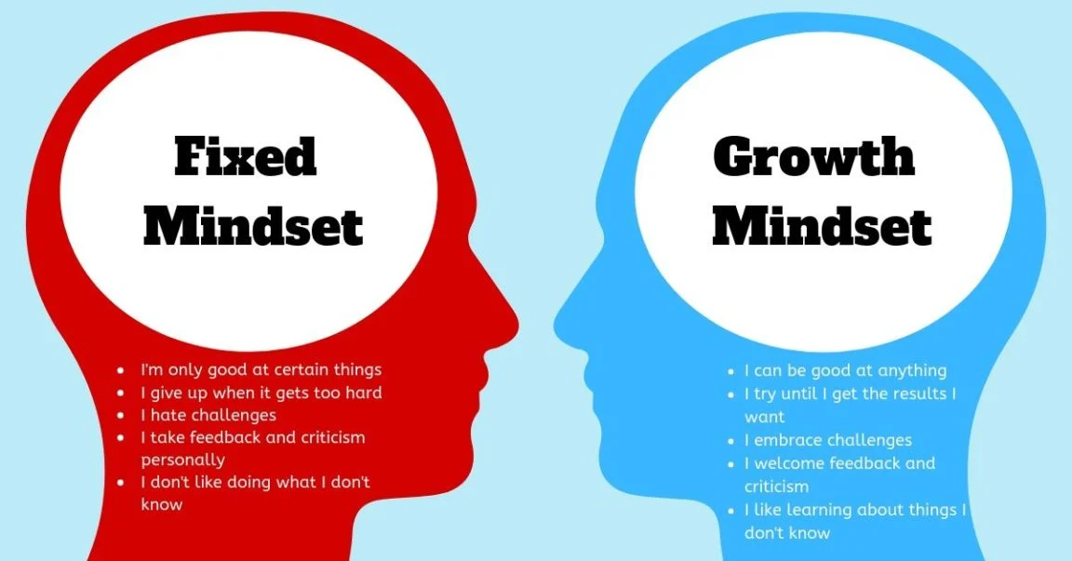
How to changed your mindset from a Fixed Mindset to a growth mindset

Slide 3
Fixed vs growth mindset
Imagine you are in the classroom. And you must carry out instruction with a new LMS, access grades and compile reports through a grading platform, and you are asked to create TEKS- aligned assessments. Your evaluations are based on how you utilize technology. Which mindset reflects you the most and what was your reaction?
There are two types of ways to view learning, challenges, or even life: Fixed or Growth Mindset.
Answer in Class Discussions

Slide 4
Fixed vs growth mindset
If you have a Growth Mindset, you may have already thought of a plan. You know what you can handle and what you are going to learn.
If you have a Fixed Mindset, you will find this task almost impossible or you may already be thinking of how you can avoid some or all of those tasks.
You can develop a Growth Mindset. You have the choice and the support to do it.

Slide 5
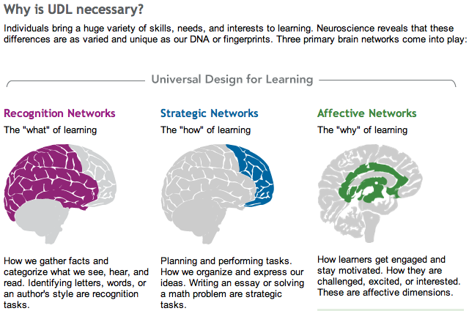
The brain
Your brain has the parts that will allow you to learn anything. You just must believe it can happen.
Your brain is an amazing tool and is ready to work for you.
Image Source: http://barbarabray.net/2012/01/20/udl-and-personalized-learning/
Answer in Class Discussions
Which is your strength? What is your ”Why” of Learning?

Slide 6
THE POWER OF ”YET”
You have "yet" to become the best educator who embraces technology and your students have "yet" to become 21st-Century Learners. What is a powerful “yet” statement that encourages you to be a 21^{st-}Century Learner with your students?
Answer in Class Discussions

Slide 7
Determine Why growth mindset is so important?
Your Students
They will have 21st-Century skills
They will be career ready
They will be use technology for the rest of their lives
They will learn from failure
They will become problem-solvers.
You
Build your intelligence
You can do anything you put your mind to
Produce a positive environments for your students
Produce 21st-Century Learners
Build your own 21st-Century Skills
Answer in Class Discussions
Why is it so important to you? How would a fixed mindset affect you?

Slide 8
DETERMINE YOUR MINDSET
Dweck offers a self-test in Mindset: The New Psychology of Success and is outlined by Scott Jeffrey.
Which two statements do you most identify with?
1
The intelligence I was born with, is all I will ever have.
2
I can always change my intelligence.
3
I can't change my intelligence, but I can still learn.
4
I can significantly change how intelligent I am.

Slide 9
Which mindset do you lean more towards?
1. The intelligence I was born with, is all I will ever have.
2. I can always change my intelligence, no matter how much I have
3. I can't change my intelligence, but I can still learn.
4. I can significantly change how intelligent I am.
1 and 3 are fixed mindsets. 2 and 4 are growth mindsets. Acknowledge the fears your feel in your fixed mindset so that you may correct them and transition into a growth mindset.

Slide 10
4 STEPS TO CHANGE YOUR MINDSET
DWECK EXPLAINS
STEP 1: Learn to hear your fixed mindset "voice".
STEP 2: Talk back to it with a growth mindset
STEP 3: Talk back to it with a growth mindset
STEP 4: Take the growth mindset action.

Slide 11
STEP 1: Learn to hear your fixed mindset "voice".
Identify your challenges or fears of the fixed mindset.
“I haven’t ever been good at learning new forms of technology”
“I don’t want my students or colleagues to see me fail.”
“I don’t think I can learn how to use it and be able to show the students how to use it, as well.”

Slide 12
Step 2: Recognize that you have a choice.
You have the ability to choose how to learn and do what you can to deal deal with setbacks.
“I can study more.”
“I can observe others.”
“I can network and work with others. I can create a support system

Slide 13
Step 3: Talk back to it with a growth mindset voice.
You will tell your voice that you are able.
“I am capable of learning.”
“I can and I will learn for my students.
“Everyone who ever used technology has been able to learn.”

Slide 14
Step 4: Take the growth mindset action.
You will take action.
“What are my next steps?”
“Let me get ready to be the best learner during this professional development.”
“I will educated myself on this right away.”

Slide 15
Identify your voice. Complete each step for your voice.
Step1: LEARN TO HEAR YOUR FIXED MINDSET “VOICE”
Step 2: RECOGNIZE THAT YOU HAVE A CHOICE
Step 3: TALK BACK TO IT WITH A GROWTH MINDSET VOICE
Step 4: TAKE THE GROWTH MINDSET ACTION-

Slide 16
BRAINSTORM: thIS EXAMPLE SHOWS HOW I CHANGED MY MINDSET TO teach others to EMBRACE TECHNOLOGY
 | My fixed mind-set | What My Growth Mind-set Should Have Been
Challenges | "I cannot teach my team how to effectively use our new LMS" | "My team struggles to utilize our new LMS, but I will support and encourage them. I will show them the benefits because they can learn."
Obstacles | "They have limited skills and won't risk altering their current instructional style." | "They haven't learned how to use it to benefit them yet, but they will.
Effort | "Testing will dominate and my ideas won't stand a chance." | "I will make people see the benefits. Scores will speak for themselves. It is worth it. We will it together, fails sometimes, but work through it."
Criticism | "My team will not like my ideas. They will think it was a waste of time and resources." | "Can't please everyone, but my heart is in the right place. Someone will use this and their kids will develop those skills."
The result | "My students and my team did not learn 21st-Century skills, nor did they see the potential of interactive learning. | "I am making a difference through our team and preparing our students for the future."

Slide 17
BRAINSTORM:
USE YOUR FIXED MINDSET TO BUILD a GROWTH MINDSET
DON'T FORGET THE "WHO" AND THE "WHY" OF THIS JOURNEY
 | My fixed mind-set | What My Growth Mind-set Should Have Been
Challenges
Obstacles
Effort
Criticism
The result

Slide 18

TAKING RISKS IS HOW YOU LEARN
Acknowledge you’re the fears your feel in your fixed mindset so that you may correct them and transition into a growth mindset. Your mindset is everything.
This Photo by Unknown Author is licensed under CC BY-SA-NC

Slide 19

resources TO HELP YOU ON YOUR JOURNEY
The Growth Mindset: Khan Academy
What is Universal Design for Learning (UDL)?
Complete Guide to Changing Your Fixed Mindset into a Growth Mindset
Developing a Growth Mindset with Carol Dweck
Growth Mindset vs. Fixed Mindset

Slide 20
HOW I CAN SUPPORT YOUR GROWTH and when
HOW and WHEN
Trainings (2 x per month)
One-on-One assistance (anytime)
Modeling (1 x per month
Group workshops (during PLCs)
Data Analysis (during PLCs)
Team Social-Emotional Learning Session. (during PLCs)

Slide 21
REFERENCES
AHEAD. (2017, Nov. 2). What is universal design for learning (UDL)? [Video] Retrieved from https://www.youtube.com/watch?v=AGQ_7K35ysA
Dweck C. (2016). Mindset: The new psychology of success. (6th ed.) New York, NY: Random House.
Dweck, C. (2014, 9 October). Developing a growth mindset with carol dweck [VIDEO]. TED Conferences. Retrieved from https://www.youtube.com/watch?v=hiiEeMN7vbQ&feature=youtu.be.
Dweck, C [Spencer, J.] (2017, 26 March). Fixed vs. growth mindset [Video]. Retrieved from https://youtu.be/M1CHPnZfFmU
Jeffrey, Scott. (2019, December 10). A Complete guide to changing your fixed mindset into a growth mindset. Retrieved from https://scottjeffrey.com/change-your-fixed-mindset/
Khan Academy. (2014, August 19). The Growth Mindset. Retrieved from ttps://youtu.be/wh0OS4MrN3E

